Slide 1
A Tutorial: Figure Plotting and graph Drawing for Research Paper Writing
Yuchen Sha
2015.3.4

Slide 2
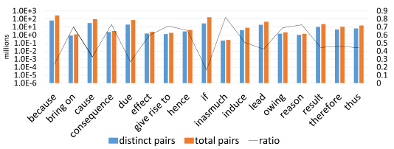
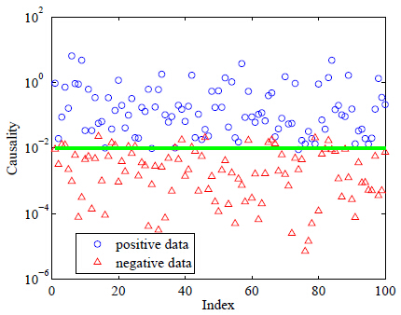
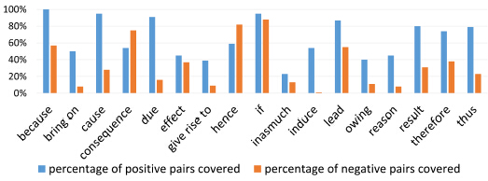
Example

Slide 3
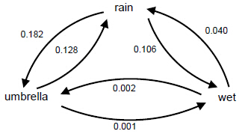
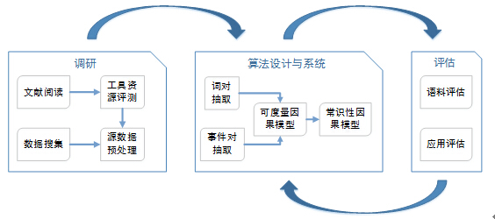
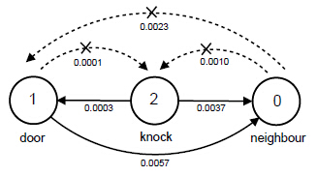
Example

Slide 4


Outline
Figure plotting
Excel or PowerPoint
Matlab
Gnuplot
Graph drawing
Dia
Visio
Other

Slide 5
Excel/PowerPoint
pattern | distinct pairs | total pairs | ratio
because | 64498441 | 273076677 | 0.236192
lead | 19136313 | 45027909 | 0.424988
give rise to | 1338256 | 1875176 | 0.71367
thus | 6832754 | 15508508 | 0.440581
due | 20140291 | 75298111 | 0.267474
effect | 1577794 | 2638447 | 0.598001
hence | 2858655 | 4360134 | 0.655635
inasmuch | 203198 | 247224 | 0.821919
reason for | 1052076 | 1445403 | 0.727877
owing | 1475083 | 2134045 | 0.691215
therefore | 4891721 | 10627384 | 0.460294
result from | 10276628 | 23107356 | 0.444734
bring on | 860554 | 1226141 | 0.701839
consequence | 2378598 | 3247347 | 0.732474
include | 4153800 | 8190629 | 0.507141
cause | 31487116 | 95947244 | 0.328171
if | 27925879 | 169684928 | 0.164575

Slide 6
Excel/PowerPoint
Plot the figure:
Combine the histogram with line chart
Y-axis: Logarithmic scale
X-axis: Font-style
…
Convert to eps
Crop

Slide 7
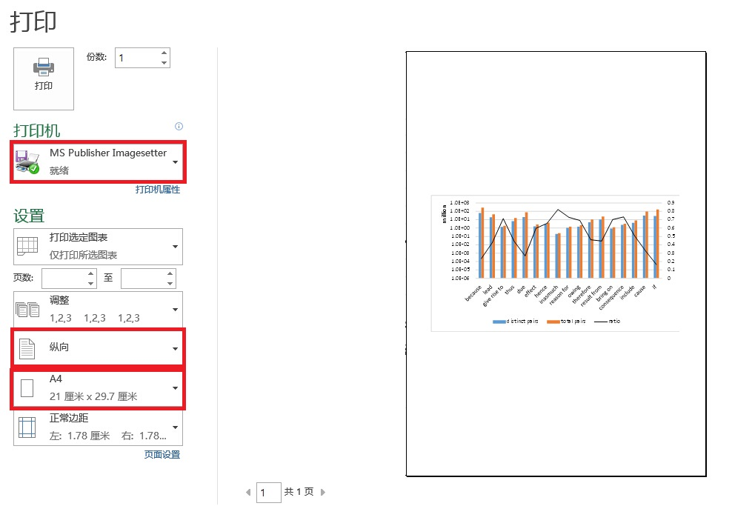
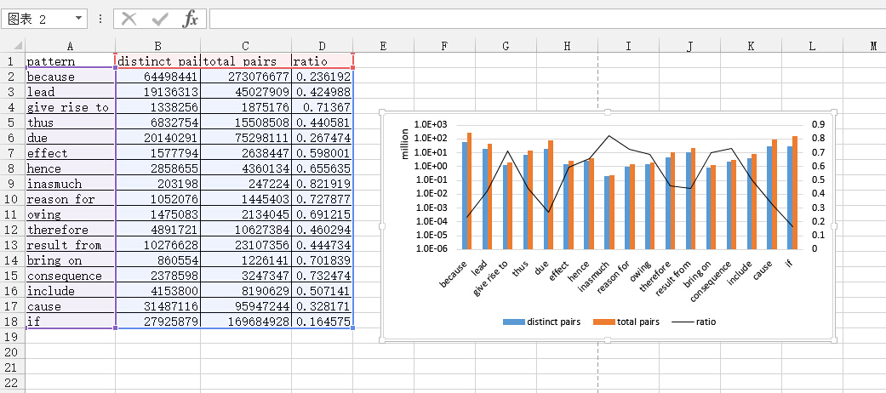
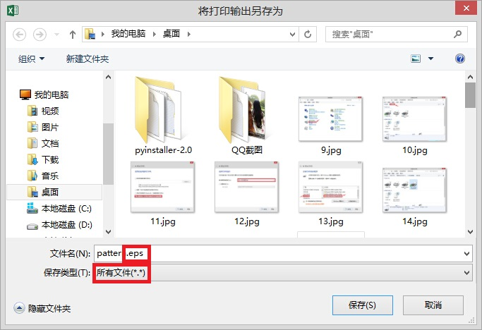
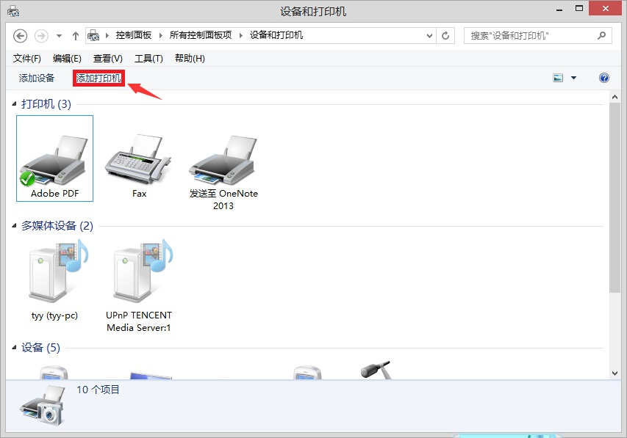
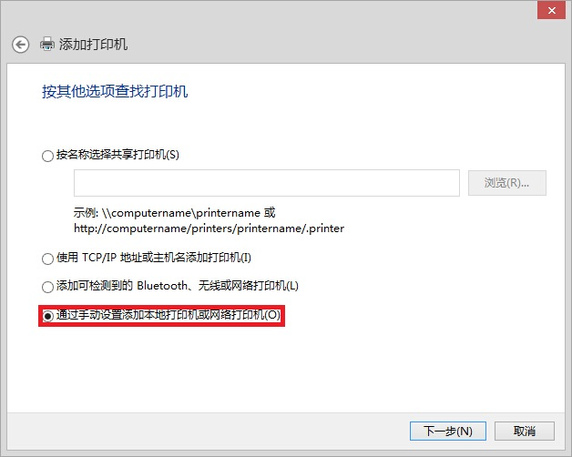
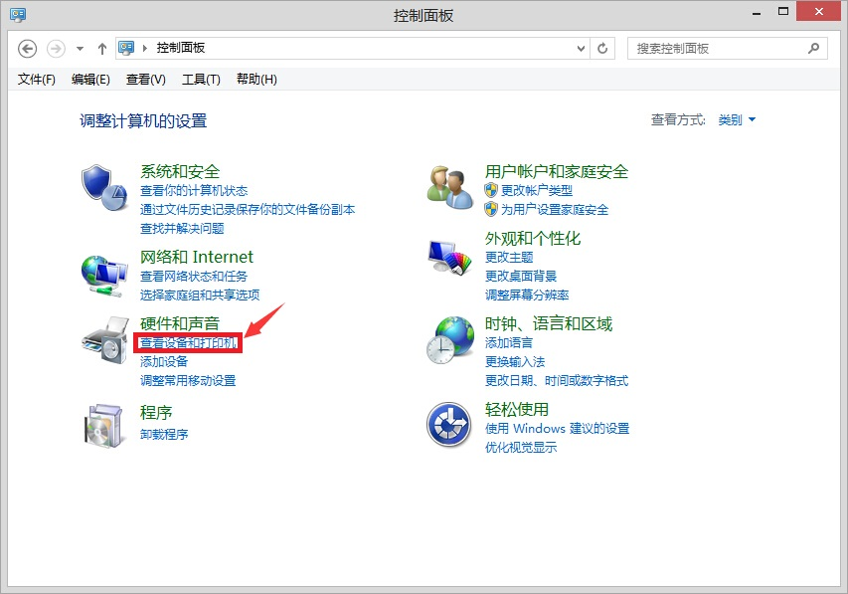
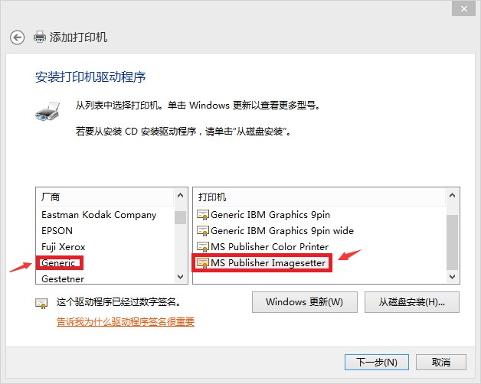
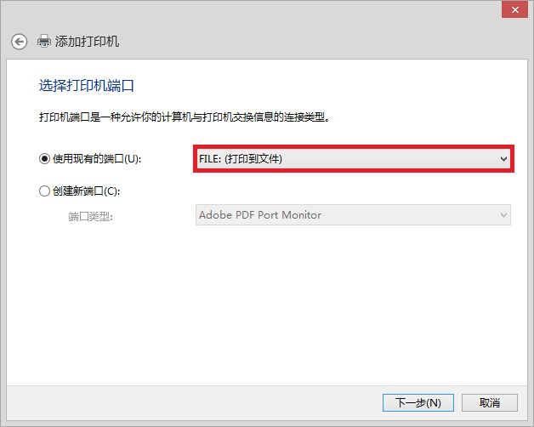
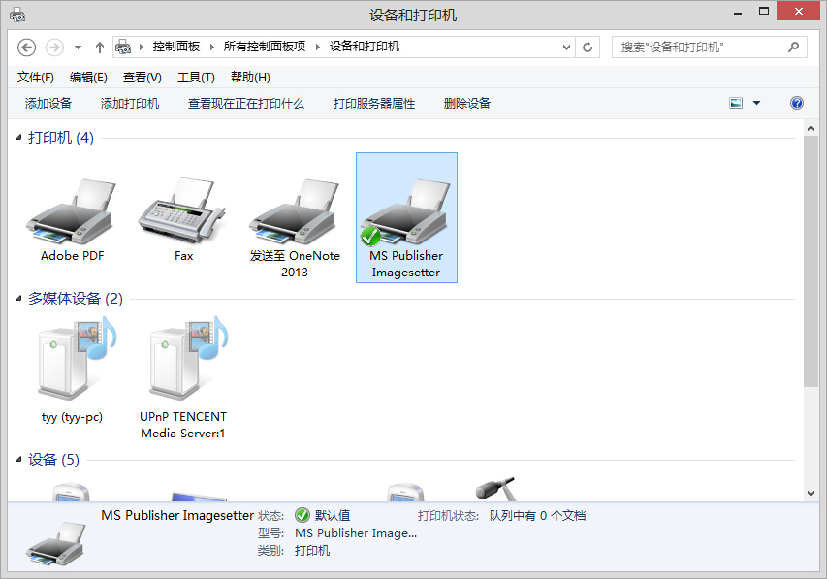
Excel/PowerPoint
Convert to eps：
Control Panel -> Check the equipment and the printer
Add printer
Manually add printer
Print to file
Choose manufacturer Generic and printer MS Publisher Imagesetter
Print

Slide 8
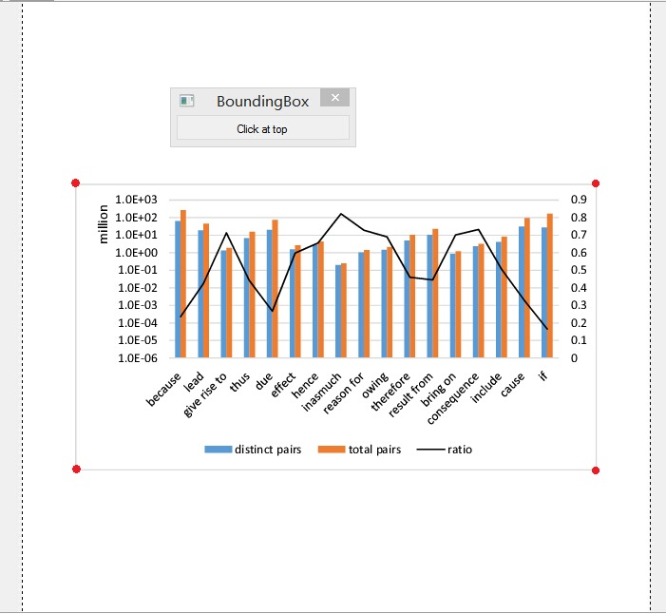
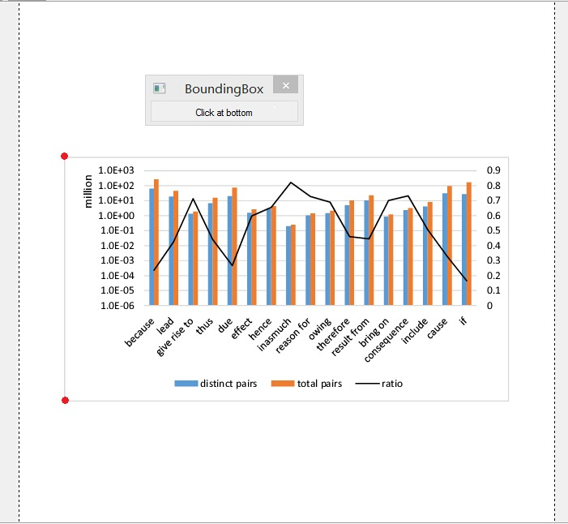
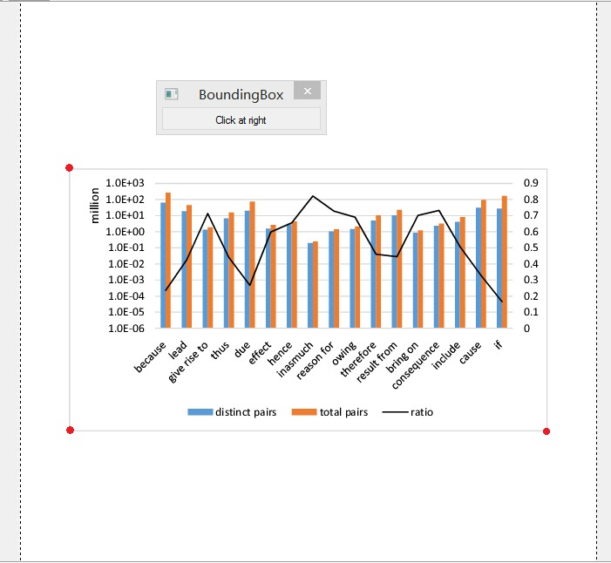
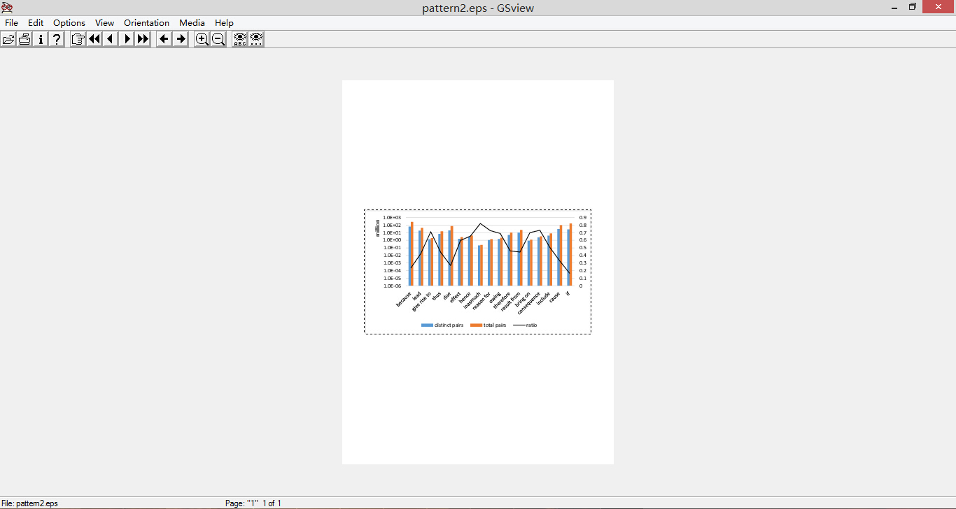
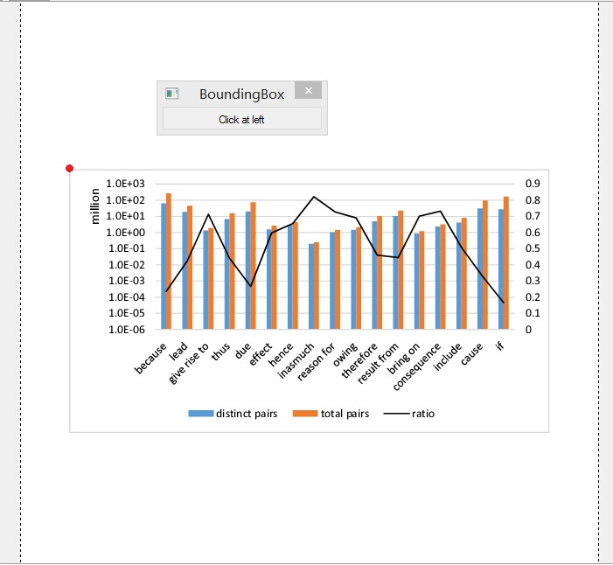

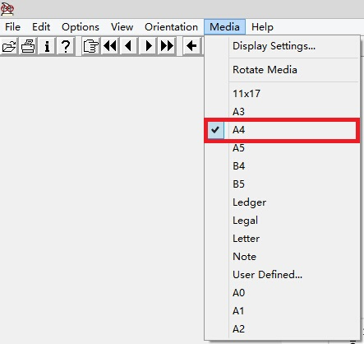
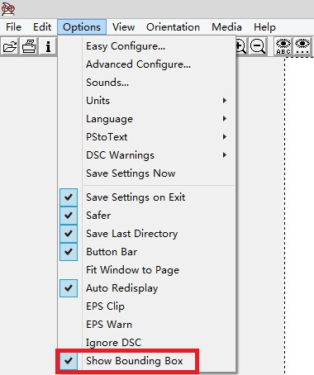
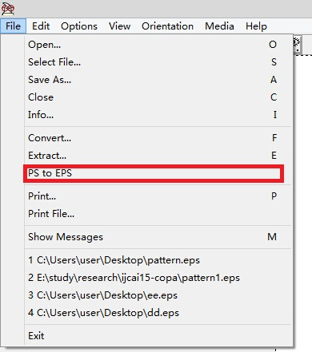

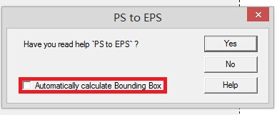
Excel/PowerPoint
Crop(Gsview):
Media -> A4
Options -> Show Bounding Box
File -> PS to EPS
Calibrate the corner:
Left-up
Left-bottom
Right-bottom
Right-up

Slide 9

Outline
Figure plotting
Excel or PowerPoint
Matlab
Gnuplot
Graph drawing
Dia
Visio
Other

Slide 10
Matlab
index | positive | negative
1 | 0.939271 | 0.00924
2 | 0.019522 | 0.003185
3 | 0.087878 | 0.012827
4 | 0.713771 | 0.012477
5 | 0.163637 | 0.002228
6 | 6.431667 | 9.75E-04
… | … | …
95 | 0.013153 | 5.25E-04
96 | 0.020021 | 5.07E-04
97 | 0.153359 | 0.005655
98 | 1.320311 | 3.60E-04
99 | 0.348785 | 5.06E-04
100 | 0.211157 | 0.007551

Slide 11
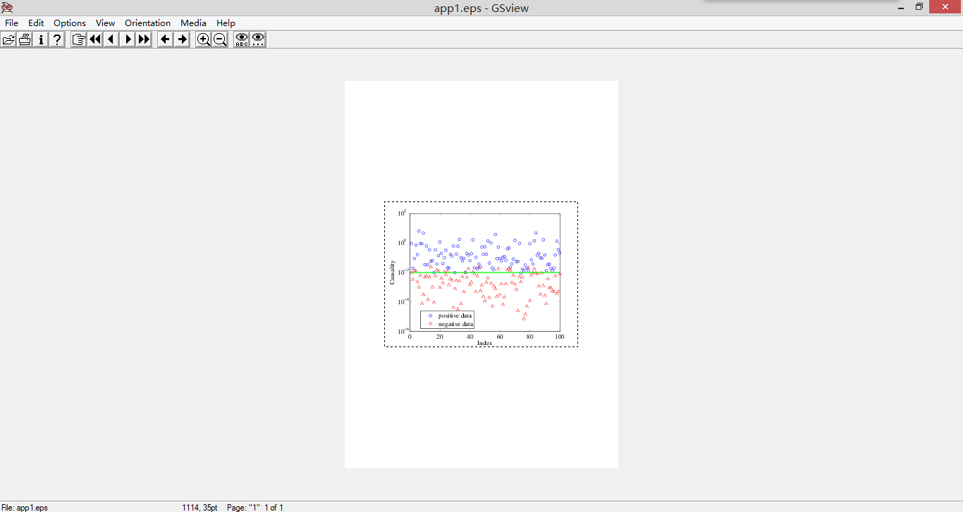
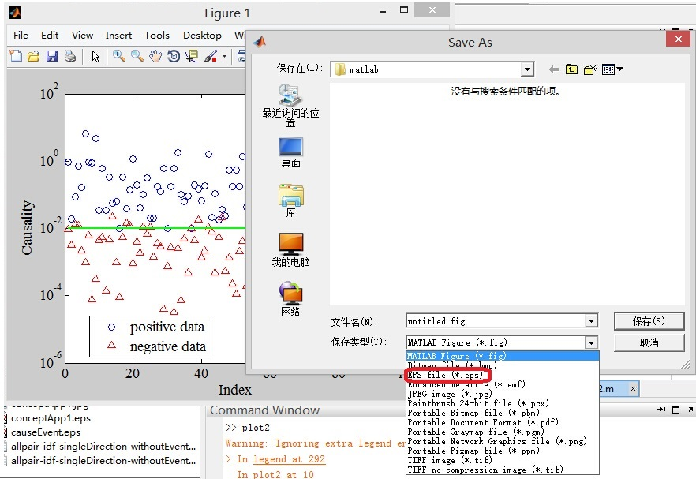
Matlab
Plot figure
Y-axis: Logarithmic scale
Legand
Color, shape, line width
…
Save as eps
(Crop)

Slide 12
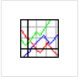
Outline
Figure plotting
Excel or PowerPoint
Matlab
Gnuplot
Graph drawing
Dia
Visio
Other

Slide 13
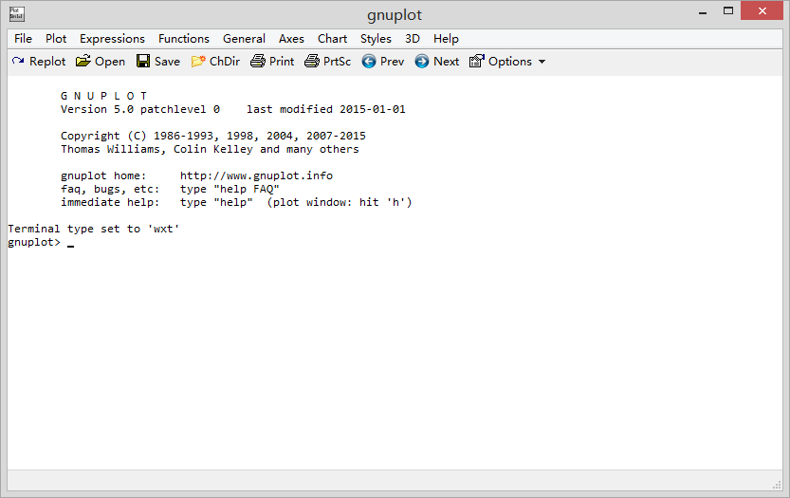
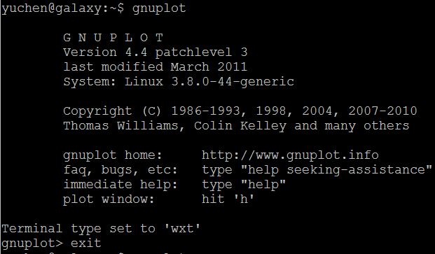
Gnuplot
Gnuplot is a portable command-line driven graphing utility for Linux, OS/2, MS Windows, OSX, VMS, and many other platforms.
The source code is copyrighted but freely distributed.
It was originally created to allow scientists and students to visualize mathematical functions and data interactively, but has grown to support many non-interactive uses.
Install and Run:
For Linux:
Install by the command: apt-get install gnuplot
Run by the command “gnuplot” and enter the gnuplot shell
For Windows:
Download the gnuplot zip file, unzip the file.
In \gnuplot\bin, double click the file wgnuplot.exe

Slide 14
Gnuplot: commands
All the parameters of commands in gnuplot are set by command set.
set terminal postscript eps color solid linewidth 2 "Helvetica" 20
set term pdfcairo font “sans,12 ”
set xrange [-1:1]
There are four gnuplot commands which actually create a plot: plot, splot, replot, and refresh. Plot generates 2D plots, splot generates 3D plots, and replot appends its arguments to the previous plot or splot and executes the modied command. Refresh reexecutes the previous plot or splot command using previously stored data rather than rereading data from a file.
using: predict the data while plotting
using 1:2: the first column as x-coordinate and the second as y-coordinate.

Slide 15
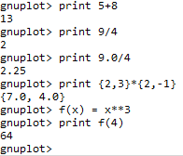
Gnuplot: mathematical expression
In general, any mathematical expression accepted by C, FORTRAN, Pascal, or BASIC is valid.
Complex constants are expressed as {<real>,<imag>}, where <real> and <imag> must be numerical constants.

Slide 16
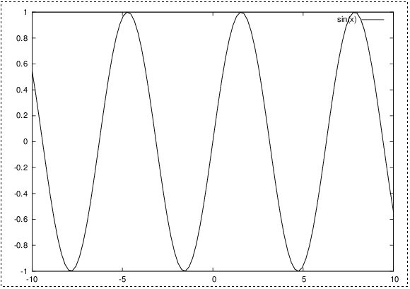
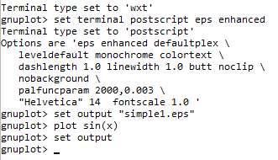
Gnuplot: a simple plotting
simple1.eps
Gnuplot supports many different graphics devices. The default terminal is “wxt” which means the output is directly shown in computer screen.
Use set terminal to tell gnuplot what kind of output to generate. Use set output to redirect that output to a file or device.
Many terminal types support an enhanced text mode in which additional formatting information is embedded
in the text string.
For example, "x^2" will write x-squared as we are used to seeing it, with a superscript
Set the file name of output
Tell gnuplot that the output has finished

Slide 17

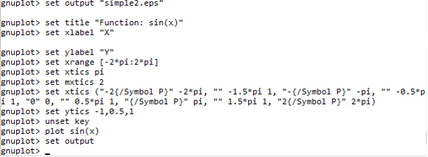
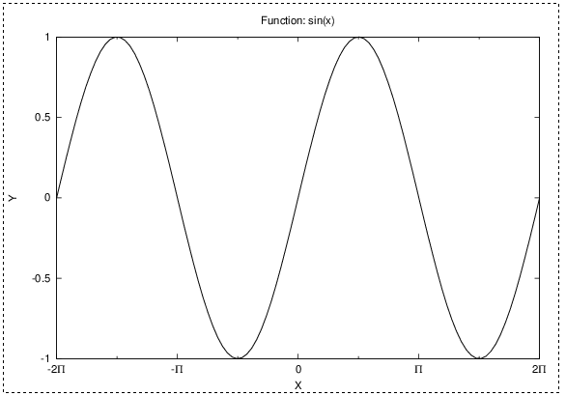
Gnuplot: a simple plotting
simple2.eps
Set main scale
Set minor scale
set xtics sets the scale. It contains 3 parts: the label, the position and the rank
Min, step size, max.

Slide 18
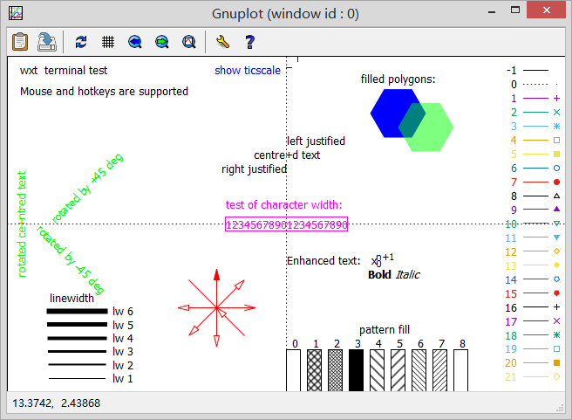
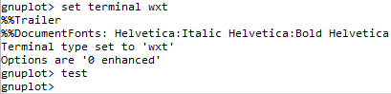
Gnuplot: line style
linetype
linewidth
linecolor
pointtype
pointsize

Slide 19
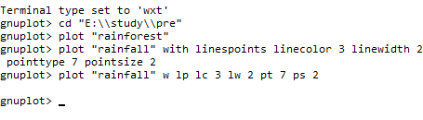
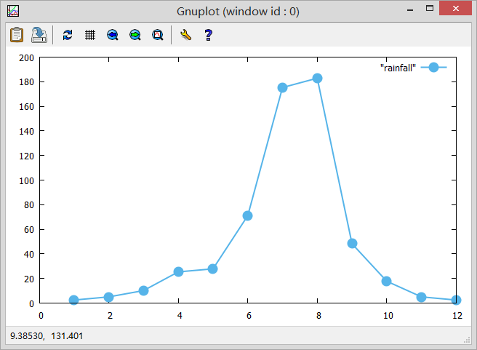
Gnuplot: line style
Month | Precipitation
1 | 2.5
2 | 5.1
3 | 10.2
4 | 25.4
5 | 27.9
6 | 71.1
7 | 175.3
8 | 182.9
9 | 48.3
10 | 17.8
11 | 5.1
12 | 2.5

Slide 20
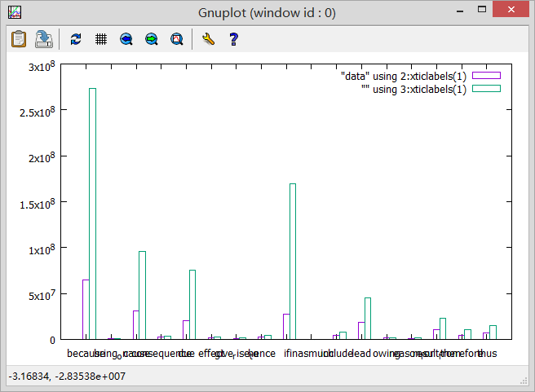
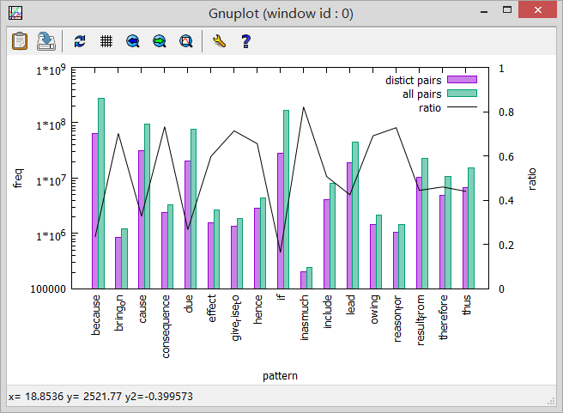
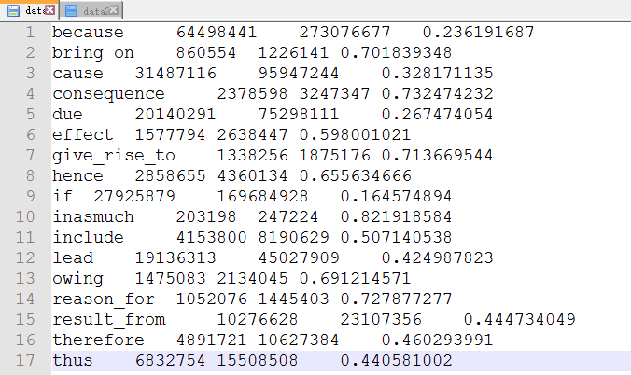
Gnuplot: my plot(1)
> cd “E:\\study\\pre”
> plot “data” using 2:xticlabels(1) with histogram, ‘’ using 3:xticlabels(1) with histogram
> set logscale y
> set xlabel “pattern”
> set ylabel “freq”
> set ytics nomirror
> set format y “%H”
> set style histogram clustered gap 2
> set style fill solid 0.5 border
> set xtics rotate
> replot
> set y2range [0:1]
> set y2label “ratio”
> set y2tics
> plot "data" using 2:xticlabels(1) with histogram title “distinct pairs”, ‘’ using 3:xticlabels(1) with histogram title “all pairs”, ‘’ using 4:xticlabels(1) with lines axis x1y2 lc -1 title “ratio”

Slide 21
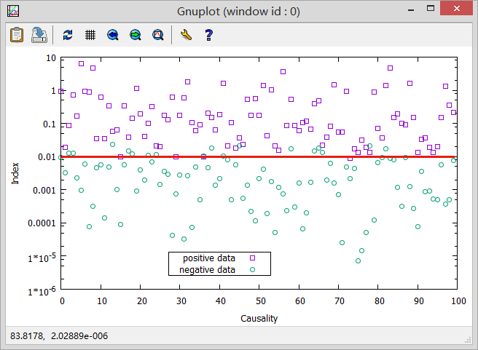
Gnuplot: my plot(2)
> cd "E:\\study\\pre”
> set logscale y
> plot "data2" using 1 with points pt 4 title "positive data” , '‘’using 2 with points pt 6 title "negative data", 0.01 with lines lc 7 lw 3 title "“
> set key center at 40,0.000006
> set xlabel "Causality”
> set ylabel "Index”
> set format y "%H”
> replot

Slide 22
References
Homepage: http://www.gnuplot.info
Manual: http://www.gnuplot.info/docs_5.0/gnuplot.pdf
Chinese manual: http://www.baidu.com/link?url=2mSb4A857UiPCBUd6ha58FmSmtqMqoWyRrsh_PJN3Gk0F83BvxrNMqC5uFBQbU7MquYwe-EMalzBApcESS5H6NwP5xG8P1VgAgKrmxlHkhW&wd=gnuplot&issp=1&f=8&ie=utf-8&tn=baiduhome_pg&inputT=1862
Blog: http://blog.sciencenet.cn/blog-373392-535918.html

Slide 23

Outline
Figure plotting
Excel or PowerPoint
Matlab
Gnuplot
Graph drawing
Dia
Visio
Other

Slide 24
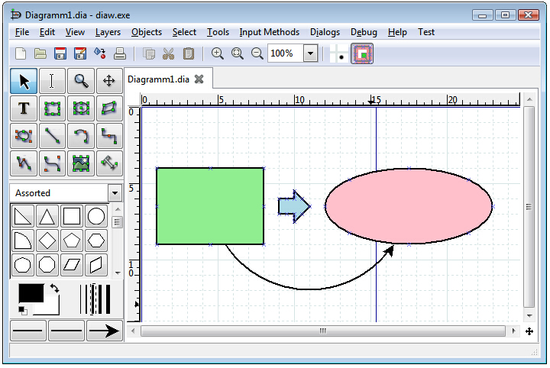
Dia
Dia is an application for creating technical diagrams. Its interface and features are loosely patterned after the Windows program Visio. Features of Dia include multiple-page printing, export to many formats (EPS, SVG, CGM and PNG), and the ability to use custom shapes created by the user as simple XML descriptions.
Dia is useful for drawing UML diagrams, network maps, and flowcharts.

Slide 25
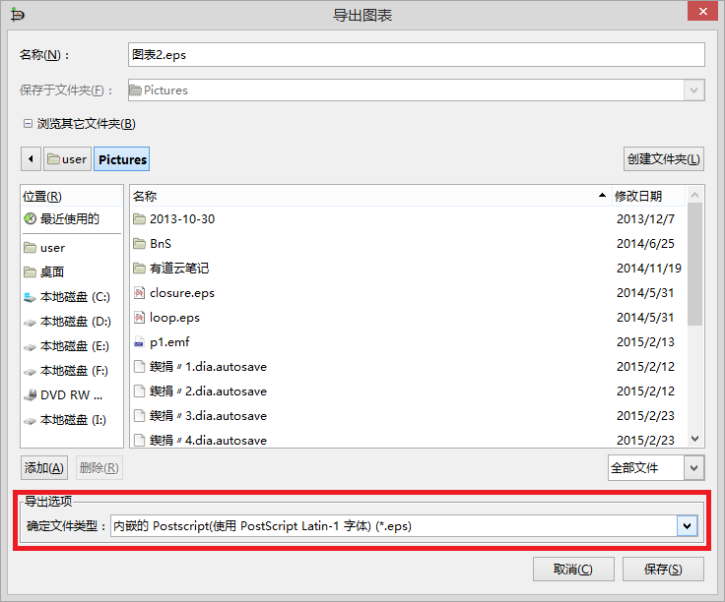
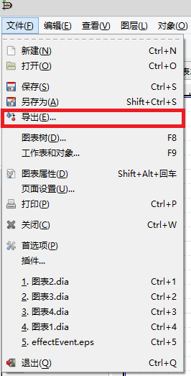
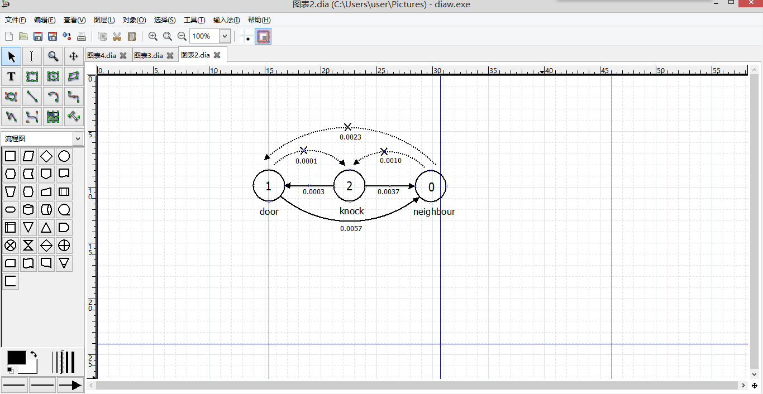
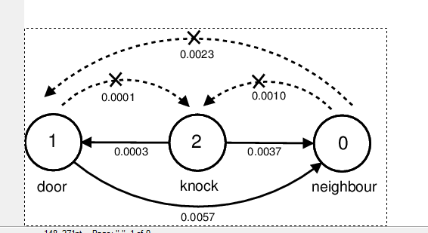
Dia

Slide 26

Outline
Figure plotting
Excel or PowerPoint
Matlab
Gnuplot
Graph drawing
Dia
Visio
Other

Slide 27
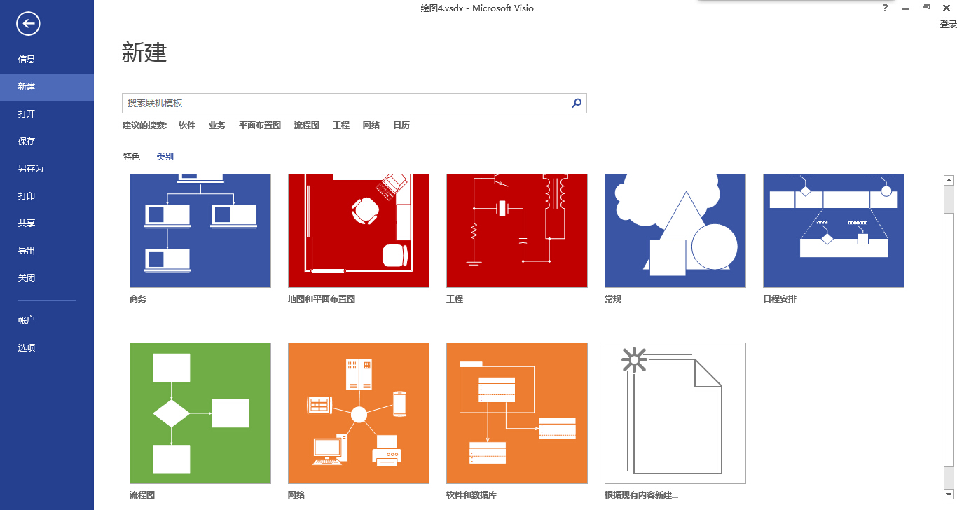
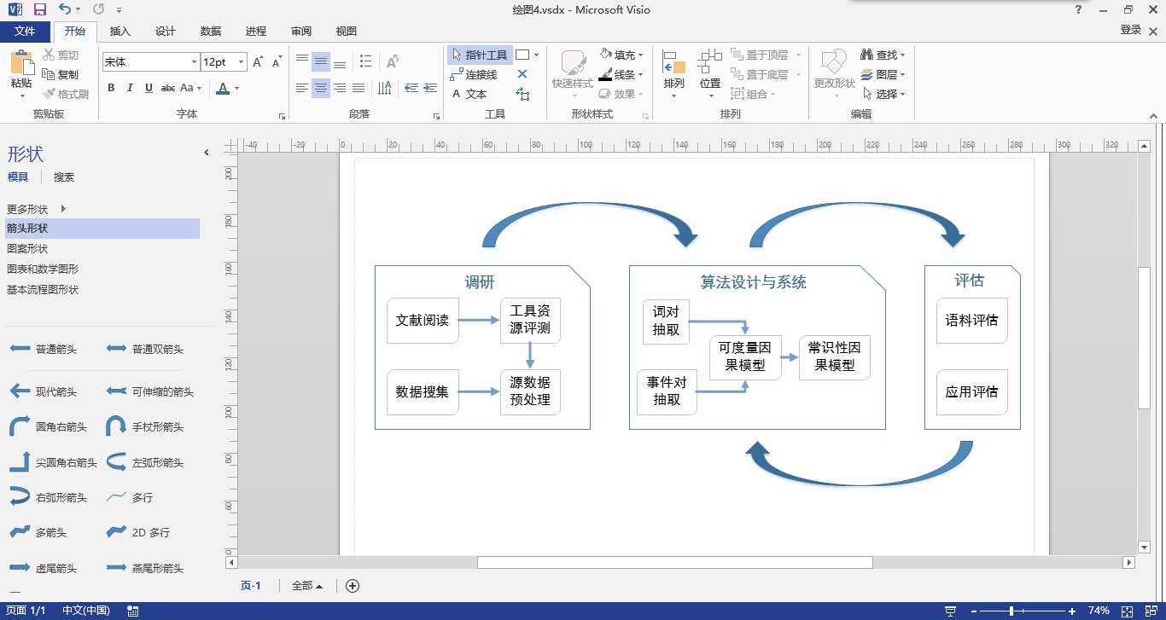
Visio
Microsoft Office Visio is a diagramming and vector graphics application.
Very powerful. Easy to use.
But not free.
Can not directly save as eps but use the same method as excel.

Slide 28
Outline
Figure plotting
Excel or PowerPoint
Matlab
Gnuplot
Graph drawing
Dia
Visio
Other

Slide 29
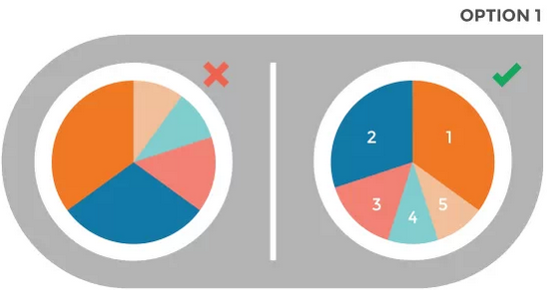

Other
TIP I
Do not split one pie chart into more than 5 parts.
To emphasize your key point:
The biggest part is in the direction of 12 o’clock and the others are placed from big to small in counter clockwise.
The biggest part is in the direction of 12 o’clock and the others are placed from big to small in clockwise.

Slide 30


Other
TIP II
In line chart, the dash line may divert the reader’s attention. So it is better to use solid line and different color.
TIP III
In scatter diagram, you can add the trend line to help reader understand the data.

Slide 31

Other
TIP IV
Organize the data according to alphabetical order, size or significance.

Slide 32


Other
TIP V
When you want to compare the data, choose an appropriate way.
TIP VI
Do not use the 3D if you can display it in 2D, which may twist one’s perception and skew the data.

Slide 33
Thank you!

